Slide 1



International Institute of Professional Studies, DAVV, Indore
System flowcharts
Submitted by:
Nitin Dwivedi IT-2K19-37
M.tech(5th sem)
Submitted to:
Dr. Shaligram Prajapat Sir

Slide 2
1. Purpose

Slide 3
A system flowchart is a concrete, physical model that documents, in an easily visualized, graphical form, the system’s discrete physical components (its programs, procedures, files, reports, screens, etc.).

Slide 4
2. Strength, Weaknesses and limitations

Slide 5
strength
It shows how the system’s major components fit together and interact.
A system flowchart is an excellent tool for summarizing a great deal of technical information about the existing system.
A system flowchart can also be used to map a hardware system.
System flowcharts are valuable as project planning and project management aids. Using the system flowchart as a guide, discrete units of work (such as writing a program or installing a new printer) can be identified, cost estimated, and scheduled. On large projects, the components suggest how the work might be divided into subsystems.

Slide 6
Weaknesses & limitations
A system flowchart’s symbols represent physical components, and the mere act of drawing one implies a physical decision.
Consequently, system flowcharts are poor analysis tools because the appropriate time for making physical decisions is after analysis has been completed.
A system flowchart can be misleading.
For example, an on-line storage symbol might represent a diskette, a hard disk, a CD-ROM, or some combination of secondary storage devices. Given such ambiguity, two experts looking at the same flowchart might reasonably envision two different physical systems.
Consequently, the analyst’s intent must be clearly documented in an attached set of notes.

Slide 7
3. Inputs and related ideas

Slide 8
The first step in drawing a system flowchart is to identify the system’s physical components by using such tools as automation boundaries.
Some analysts prefer to use physical data flow diagrams to document physical alternatives.
A completed system flowchart is sometimes used to support the project planning stage.
During the design stage, a system flowchart serves as a high-level map of the system.

Slide 9
4. Concepts

Slide 10
A system flowchart (or system flow diagram) is a concrete, physical model that documents, in an easily visualized, graphical form, the system’s discrete physical components (its programs, procedures, files, reports, screens, etc.).

Slide 11
4.1 Flowcharting symbols and conventions
On a system flowchart, each component is represented by a symbol that visually suggests its function (Figure 1.1).
The symbols are linked by flowlines.
A given flowline might represent a data flow, a control flow, and/or a hardware interface.
By convention, the direction of flow is from the top left to the bottom right, and arrowheads must be used when that convention is not followed.
Arrowheads are recommended even when the convention is followed because they help to clarify the documentation.

Slide 12
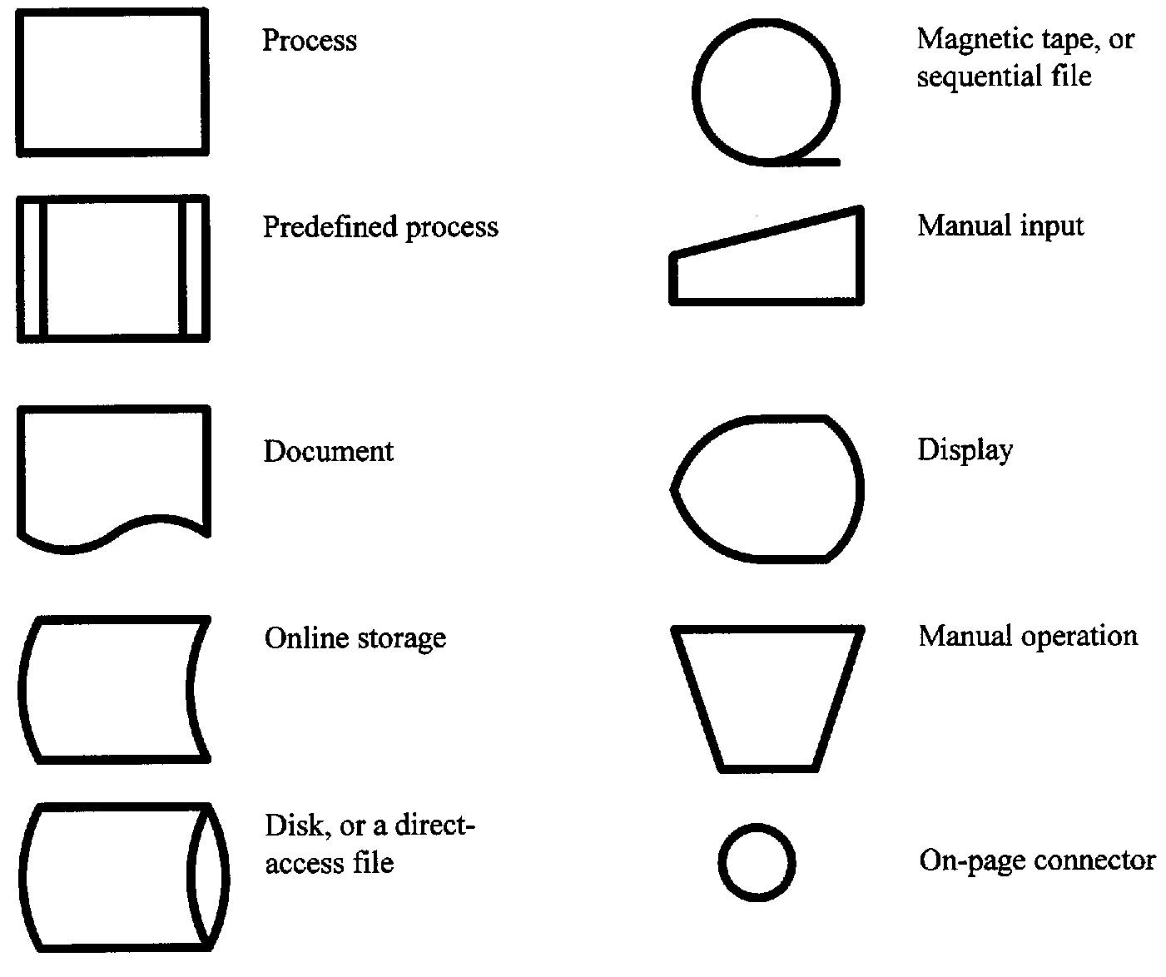
Figure 1.1

Slide 13
4.2 Predefined processes
The flowchart for a complex system can be quite large.
An off-page connector symbol (resembling a small home plate) can be used to continue the flowchart on a subsequent page, but multiple-page flowcharts are difficult to read.
When faced with a complex system, a good approach is to draw a high-level flowchart showing key functions as predefined processes and then explode those predefined processes to the appropriate level on subsequent pages.

Slide 14
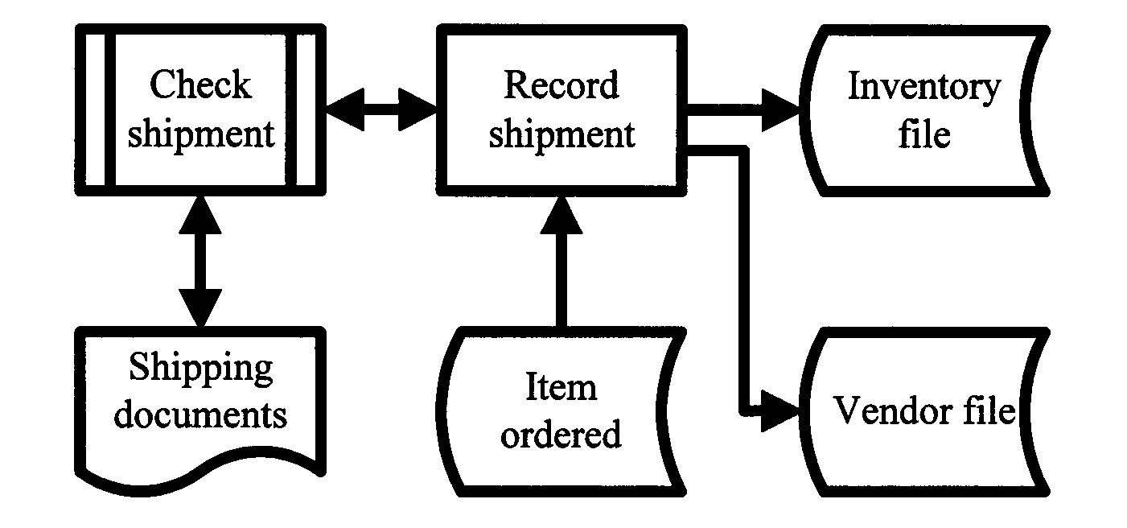
Figure 1.2 Use predefined processes to simplify a complex system flowchart.

Slide 15
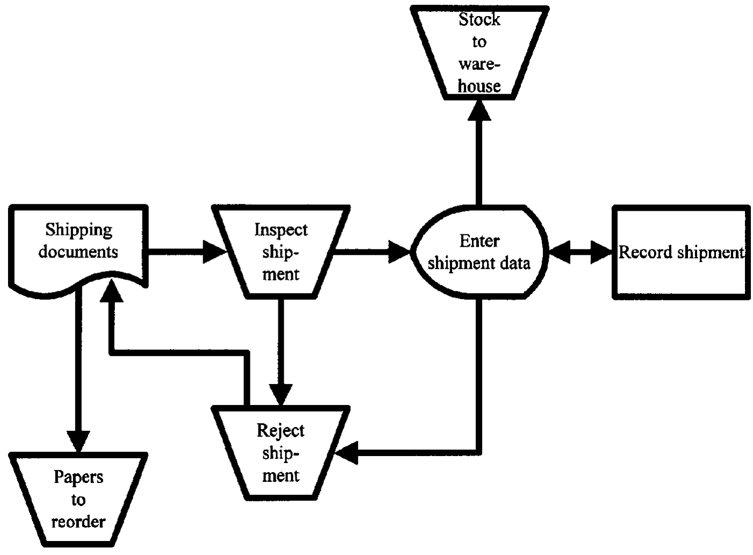
Figure 1.3 A system flowchart for the predefined process named Check shipment.

Slide 16
4.3 Supporting documentation

Slide 17
Each symbol on a system flowchart represents a discrete hardware component and either software or data.
A process symbol (a rectangle) can represent a computer, a program, or both.
An on-line storage symbol represents a disk drive, a file, or both.
A printer symbol stands for a printer, a report, or both.
A display screen represents a display unit, the data displayed on the screen, or both.
A given flowline represents a hardware interface and a control or data flow.

Slide 18
To further complicate matters, a given symbol might represent multiple components. For example, an on-line storage symbol might imply one or more hard disks, one or more CD-ROMs, or one or more diskettes.
Consequently, it is easy to misinterpret a system flowchart. Detailed notes are often attached to the diagram to clearly explain the creator’s intent.

Slide 19
5. Key terms

Slide 20
Predefined process — On a system flowchart, a high-level process that is more fully documented in a separate, lower-level flowchart.
System flowchart — A tool for documenting a physical system in which each component is represented by a symbol that visually suggests its function.

Slide 21
References
https://drive.google.com/file/d/1NGA0FyXv0OfuU9H7q_SdBxbjwDvSxx2b/view

Slide 22
Thank you!

